Slide 1
Charcoal Yields
CH.Koushik teja
22H51A66E2
CSM

Slide 2
Introduction
Charcoal yields refer to the amount of charcoal produced from a specific amount of wood or biomass.
It is an essential metric in the charcoal production industry to maximize efficiency and sustainability.
Understanding charcoal yields can help producers optimize their processes and reduce waste.
1
Notes:
Image source: https://www.researchgate.net/figure/Comparison-among-the-charcoal-yields-obtained-with-different-kilns_tbl2_336539524

Slide 3
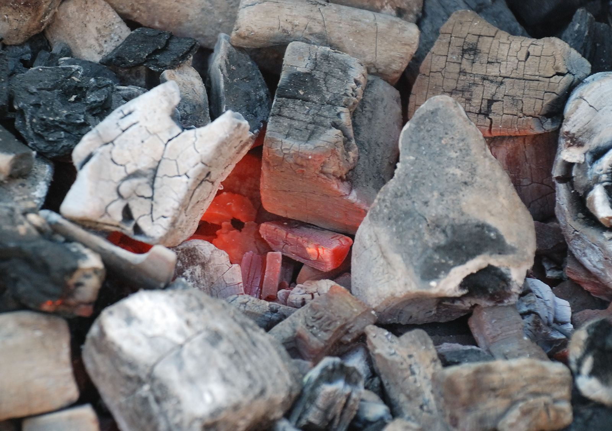
Importance of Charcoal Yields
High charcoal yields mean more efficient use of wood resources and higher profitability for producers.
Efficient charcoal yields contribute to sustainable forestry practices by minimizing waste.
Monitoring and improving charcoal yields can lead to a more environmentally friendly charcoal production process.
3
Notes:
Image source: https://www.britannica.com/science/charcoal

Slide 4
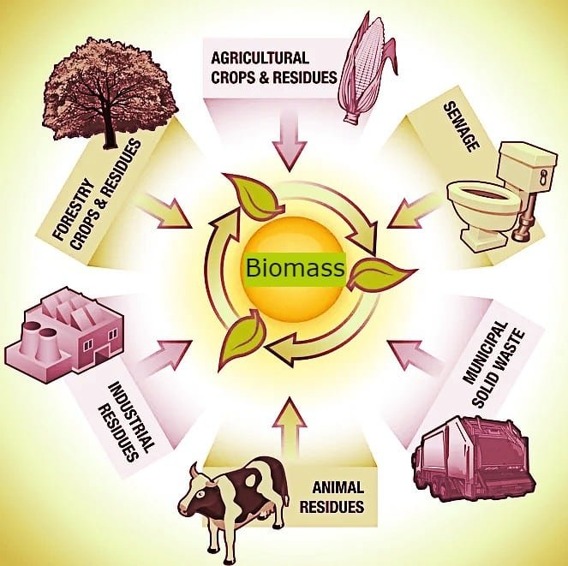
Factors Affecting Charcoal Yields
The type of wood or biomass used plays a crucial role in determining charcoal yields.
The carbonization process, including temperature and duration, can significantly impact the final yield.
Moisture content in the raw material can also affect charcoal yields.
2
Notes:
Image source: https://carboncredits.com/the-evolution-of-biomass-and-its-generations/

Slide 5
Strategies for Improving Charcoal Yields
Conducting regular analysis of wood properties to select the most suitable raw materials for high charcoal yields.
Implementing efficient carbonization techniques, such as controlling temperature and airflow, to maximize yields.
Investing in technologies like retort kilns or pyrolysis reactors to improve charcoal production efficiency and yields.
5
Notes:
Image source: https://www.researchgate.net/figure/Ultimate-and-proximate-analysis-of-wood-and-charcoal-used_tbl1_223040081

Slide 6
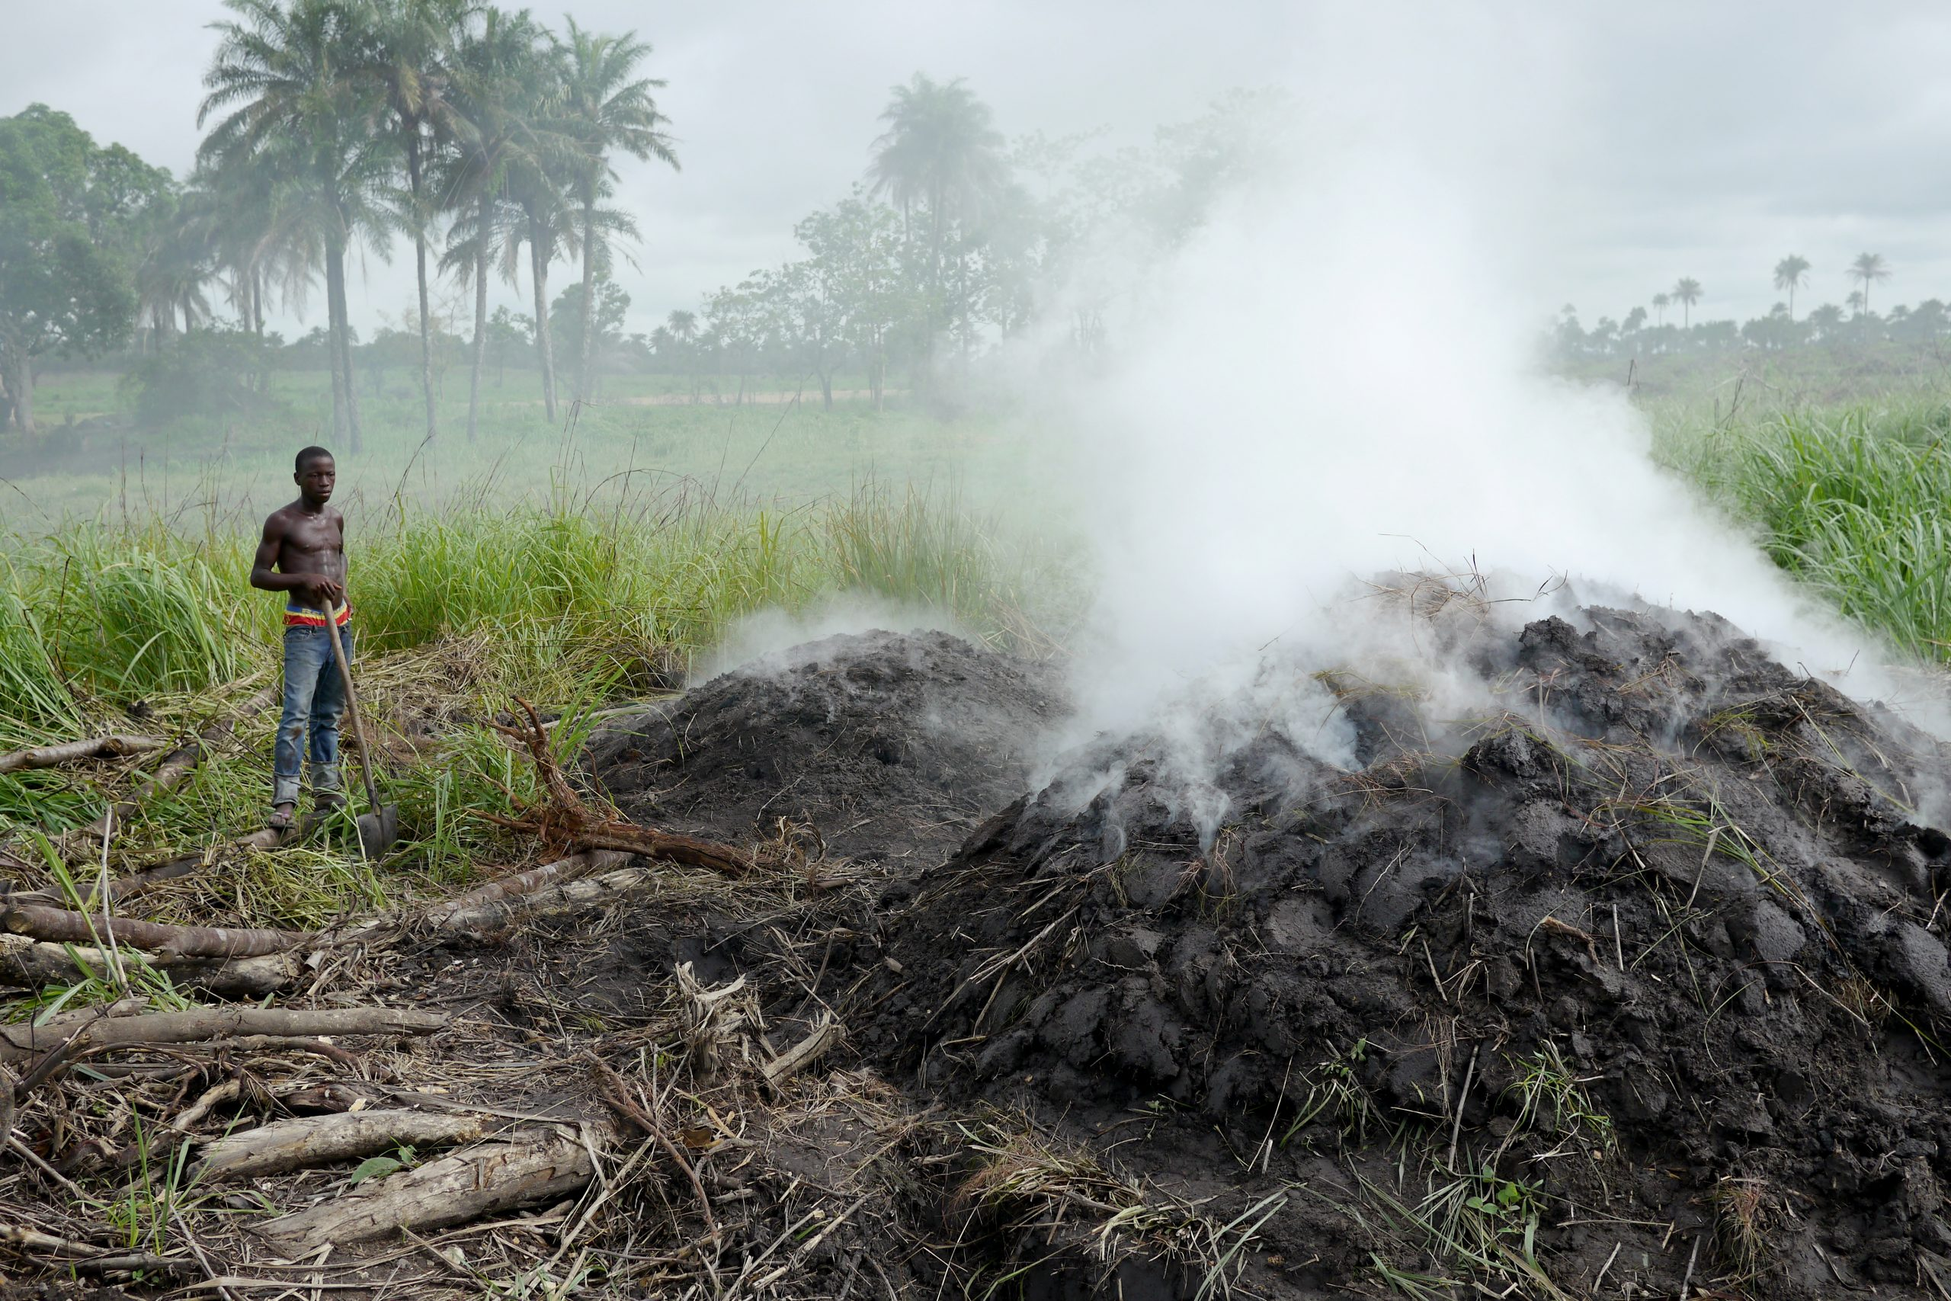
Environmental Impact of Charcoal Yields
High charcoal yields contribute to reduced deforestation by making more efficient use of wood resources.
Lower waste production from improved yields can help minimize environmental pollution.
Sustainable charcoal production practices, driven by optimized yields, support biodiversity conservation and ecosystem health.
6
Notes:
Image source: https://www.forest-trends.org/blog/charcoal-an-important-driver-of-deforestation-in-africa/

Slide 7
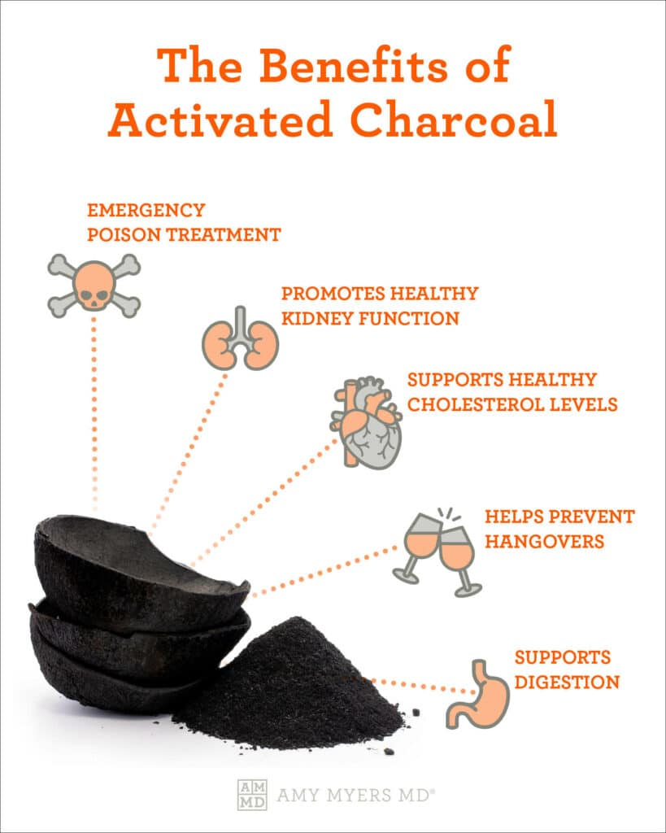
Economic Benefits of Optimizing Charcoal Yields
Increased charcoal yields lead to higher profitability for producers through reduced input costs and improved product output.
Improved yields can enhance market competitiveness and attract environmentally conscious consumers.
Long-term sustainability in charcoal production, driven by optimized yields, ensures a stable revenue stream for producers.
7
Notes:
Image source: https://www.amymyersmd.com/article/activated-charcoal-benefits

Slide 8
Conclusion
Charcoal yields are a critical measure in the charcoal production industry to enhance efficiency and sustainability.
By understanding the factors affecting charcoal yields and implementing strategies to optimize them, producers can achieve economic viability and environmental stewardship.
Continuous improvement in charcoal yields benefits both producers and the environment, making it a key aspect of sustainable charcoal production.
8
Notes:
Image source: https://www.researchgate.net/figure/14-Regional-shares-of-charcoal-production-2000-and-2013_fig3_334085317

Slide 9
Thank you for your attention!
9
Notes:
Image source: https://slideuplift.com/powerpoint-templates/thank-you-slide-05/

